Slide 1
Trending YouTube Video
By Elham Emami

Slide 2
Introduction
2
The dataset is from Kaggle called “Trending YouTube Video Statistics”
The data contains json and CSV files
The Dataset contains data for about 335000 trending videos.
The main purpose of this project:
The common features of trending videos
Predict the view number of video

Slide 3
Data Overview
3
The CSV files contain the YouTube video data
the JSON files include data related to the video category
More details such as channel related information have been extracted from the YouTube API

Slide 4
Data overview-Cont.
4
video_id | trending_date | title | category_id | publish_time | channel_title | … | likes | Dislike | comment_count
n1WpP7iowLc | 17.14.11 | Eminem - Walk On Water (Audio) ft. Beyoncé | 10 | 2017-11-10T17:00:03.000Z | EminemVEVO |  | 787425 | 43420 | 125882
0dBIkQ4Mz1M | 17.14.11 | PLUSH - Bad Unboxing Fan Mail | 23 | 2017-11-13T17:00:00.000Z | iDubbbzTV |  | 127794 | 1688 | 13030
5qpjK5DgCt4 | 17.14.11 | Racist Superman | Rudy Mancuso, King Bach & Le... | 23 | 2017-11-12T19:05:24.000Z | Rudy Mancuso |  | 146035 | 5339 | 8181

Slide 5
Data wrangling
5
The following steps were added to clean and organize the data:
Extracted the category column from category json file
Extracted the channel related information from YouTube API
Filled the missing value columns with default value
Converted data type columns like "Trending Date" and "Published Time“

Slide 6
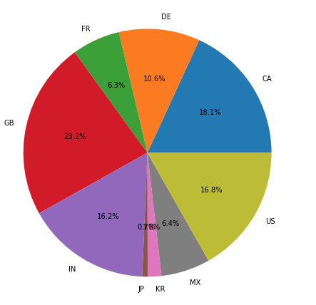
Views per country
Great Britain 23.2%
Canada 18.1%
United states 16.8%
India 16.2%
Denmark 10.6%
Mexico 6.4%
France 6.3%
Japan and South Korea 7%

Slide 7
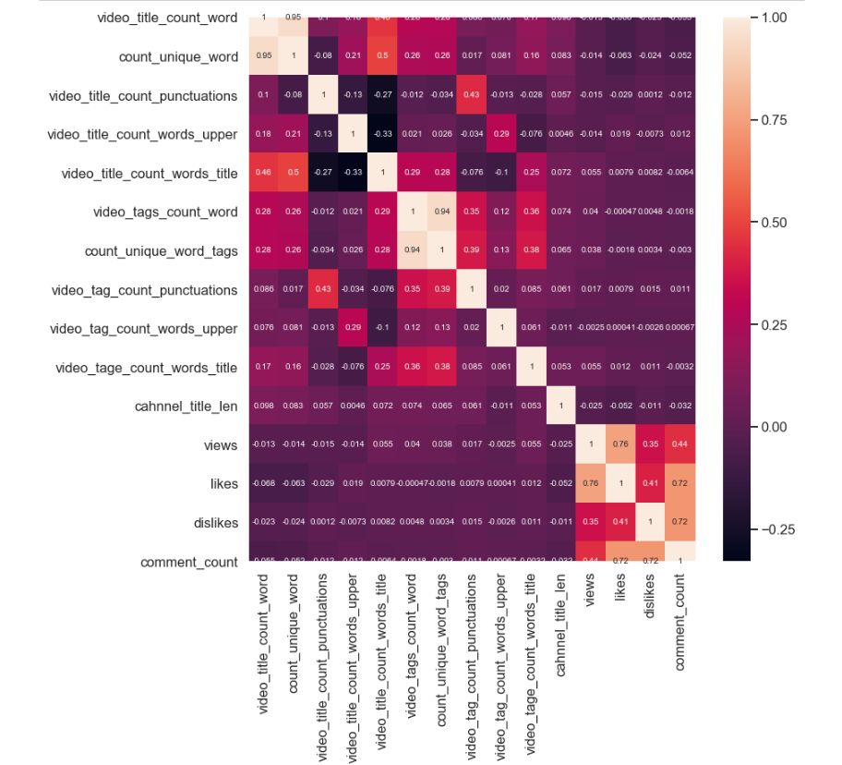
Correlation Matrix
The attributes have been extracted:
number of title’s words
Number of tag’s words
Number of title and tag’s punctuations
Number of title and tags uppercase words

Slide 8

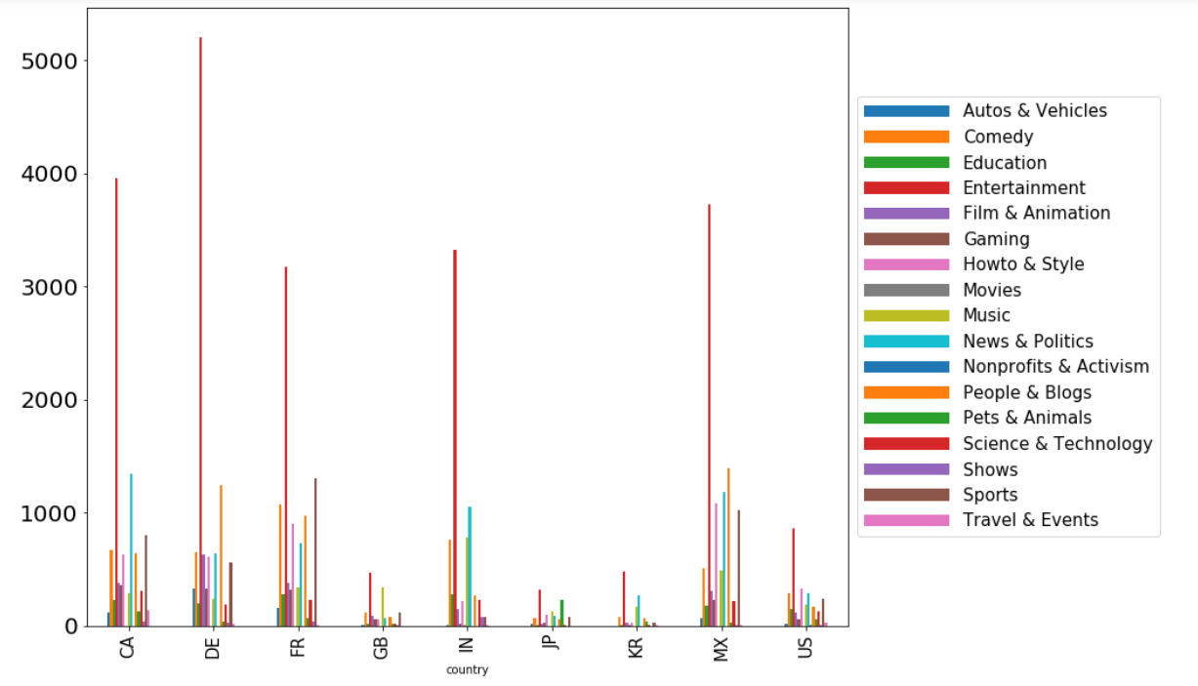



Average YouTube video’s view per category

Slide 9

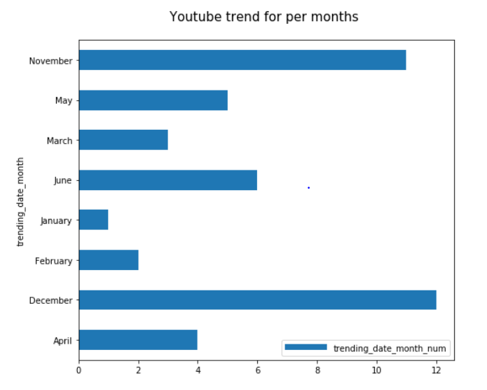
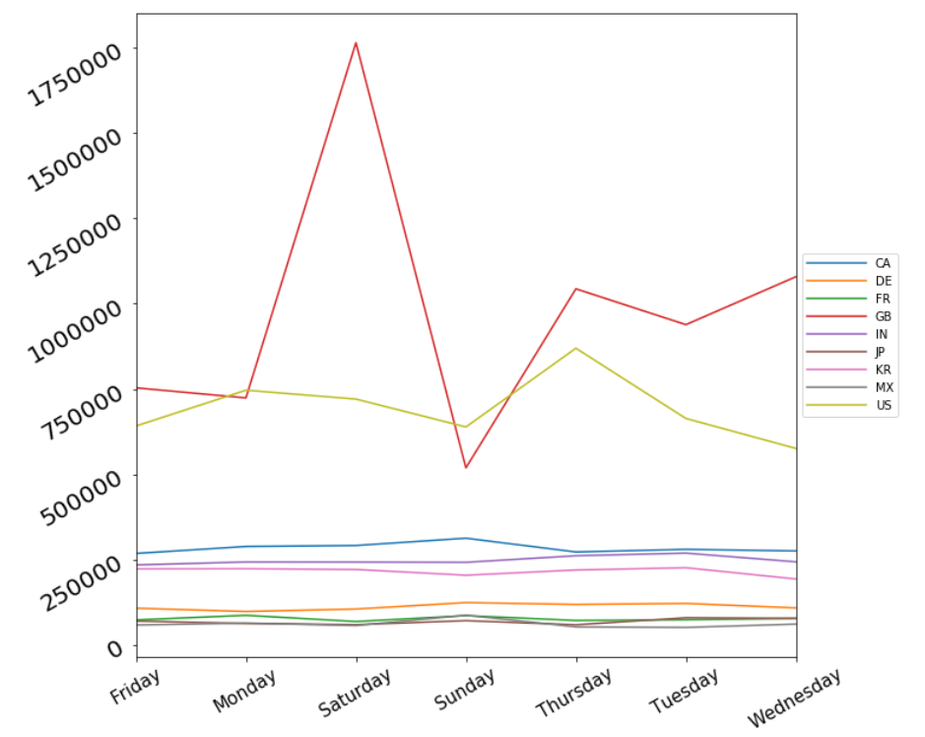
YouTube trend for visited videos in each day for each country

Slide 10
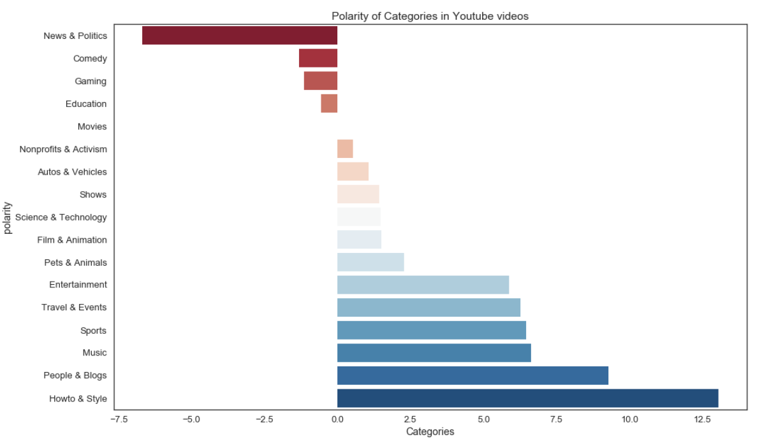
Sentiment analysis on Video's tags

Slide 11
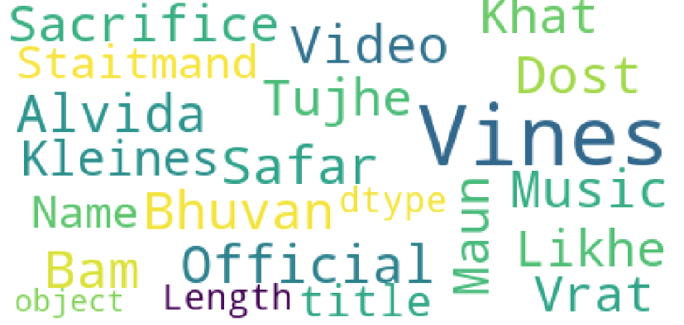
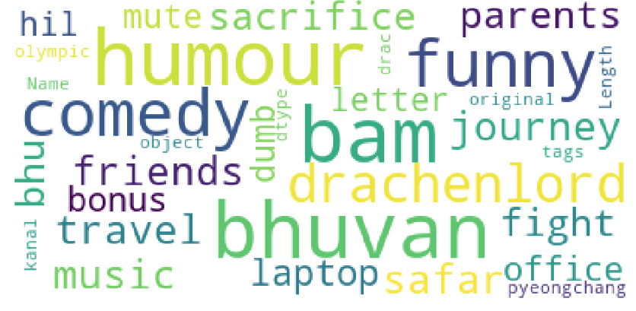
WordCloud
video title
video tags

Slide 12
Machine Learning
13
Machine learning can be used to predict the number of views.
The log of views is used as target
Dataset split into 75% training and 25% test data.
Linear
Random Forest
Gradient boosting
X-Gradient boosting

Slide 13
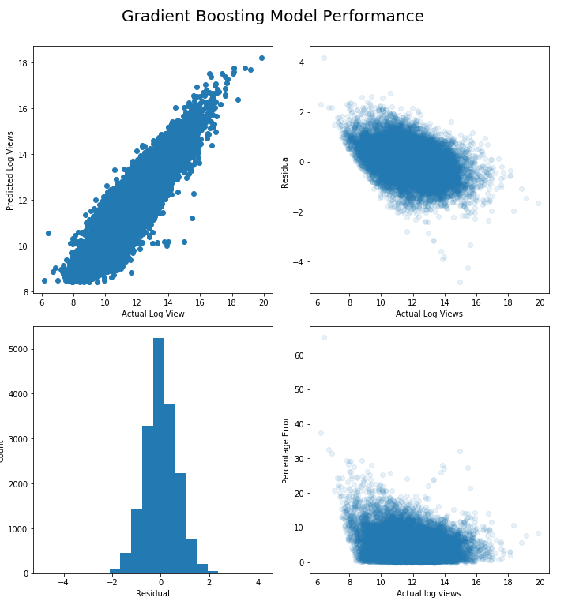
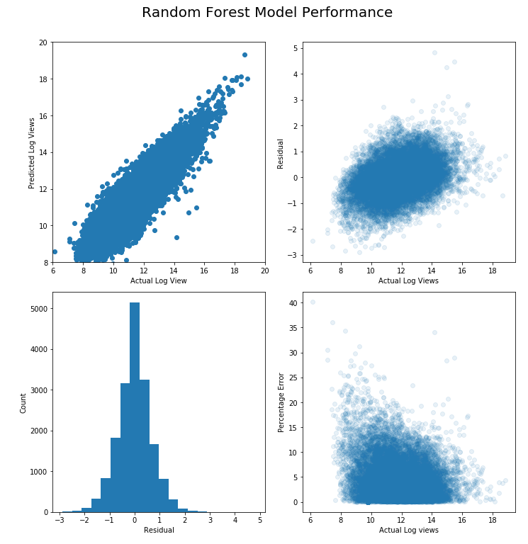
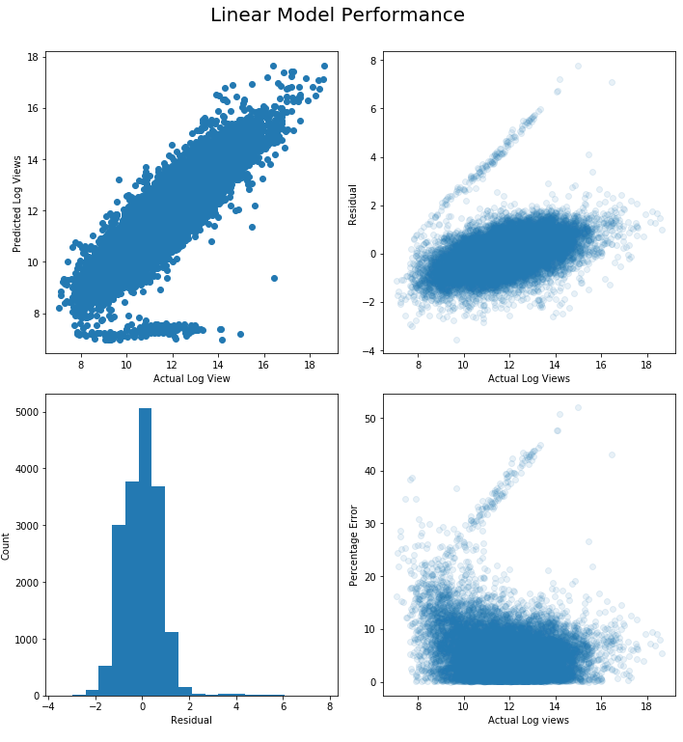
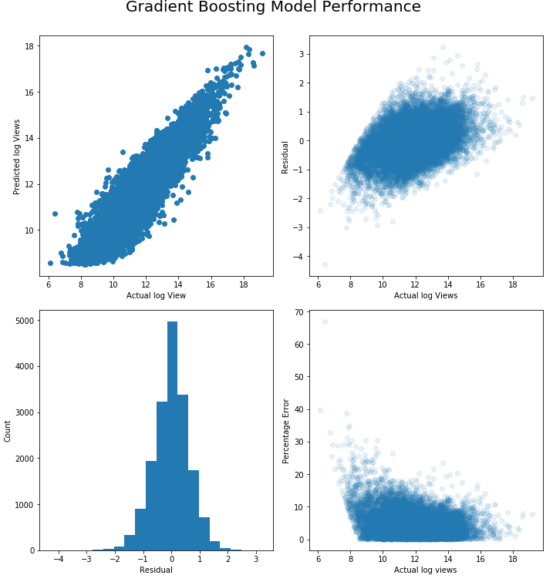
Model Performance
x

Slide 14
Model Performance
 | R² | RMSE | MAPE (%)
XGBoost | 0.8522405976757502 | 1.0 | 4.14
Gradient Boosting | 0.8350626520575262 | 1.0 | 4.39
Random Forest | 0.8305999576526518 | 1.0 | 4.28
Linear Regression | 0.7429298834704685 | 1.0 | 5.49
Random Forest, Gradient boost and Xgboost perform better than linear model
XGBoost has better metrics

Slide 15
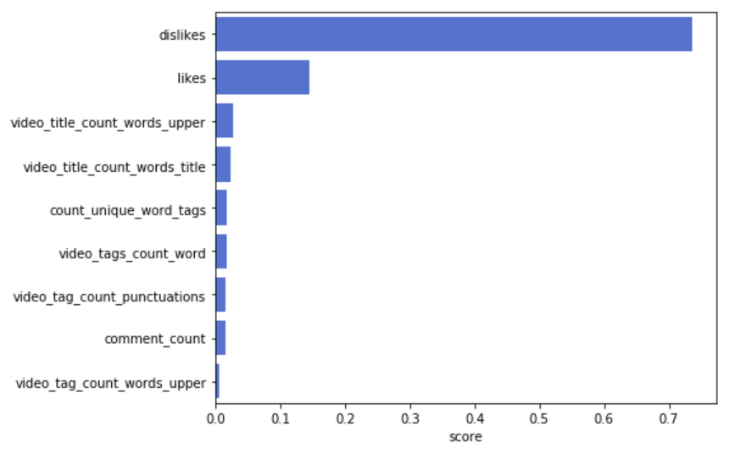
Feature Important
15
Dislikes the most important feature
Likes and title features on the list too.

Slide 16
Future work
16
Applying sentiment analysis on comments to create a more robust “user profile”
Using neural networks that can learn hidden features

